Slide 1
Enabling a conducive environment for the digital economy
Client Country : Kyrgyzstan
TA6618-Enabling a conducive environment for e-commerce
Module 2 - Digital Technologies role in enhancing business activity / e-commerce platform

Slide 2
Structure of the contents
01 – Explanatory videos
02 – Presentation with slides of the key literature
03 – Resources to review
04 – Activities of the module
05 - Quiz
TA6618-Enabling a conducive environment for e-commerce
Module 2 - Digital Technologies role in enhancing business activity / e-commerce platform

Slide 3
Course overview – Module 2
Modules/Topics
Module 1 8am-10am > Overview of e-commerce digital technology, security, a landscape view 5pm-7pm > Business Plan development
Module 2 8am-10am > Digital Technologies role in enhancing business activity / e-commerce platforms 5pm-7pm > Business Plan development
Module 3 8am-10am > Entrepreneurial case studies on e-commerce digital technology, (eg Amazon, Alibaba, Tmall, Taobao, JD.com, eBay, Wildberries, Ozon, freelance 5pm-7pm > Business Plan development
Module 4 8am-10am > Technologies and Strategies in e-commerce digital technology approaches & legal framework 5pm-7pm > Business Plan development
Module 5 8am-10am > Future challenges in e-commerce digital technology & business plan development 5pm-7pm > Business Plan Presentation
TA6618-Enabling a conducive environment for e-commerce
Module 2 - Digital Technologies role in enhancing business activity / e-commerce platform

Slide 4
Objectives
of the module
Digital Technologies’ role in enhancing business activity.
E-Commerce platforms.
Elaboration and presentation of business plan.
TA6618-Enabling a conducive environment for e-commerce
Module 2 - Digital Technologies role in enhancing business activity / e-commerce platform
Notes:
30

Slide 5
E-commerce – Still business
E-commerce is an end-end process of activating a request and making a delivery with payment included.
Despite this, e-business is still a business and it requires all the process of a traditional business. It just changes the way of doing, and how to access clients, providers, and how to control the flows of information and process management.
Source: https://technofaq.org/posts/2020/09/5-tips-to-spend-business-budget-wisely-on-digital-marketing/
TA6618-Enabling a conducive environment for e-commerce
Module 2 - Digital Technologies role in enhancing business activity / e-commerce platform

Slide 6
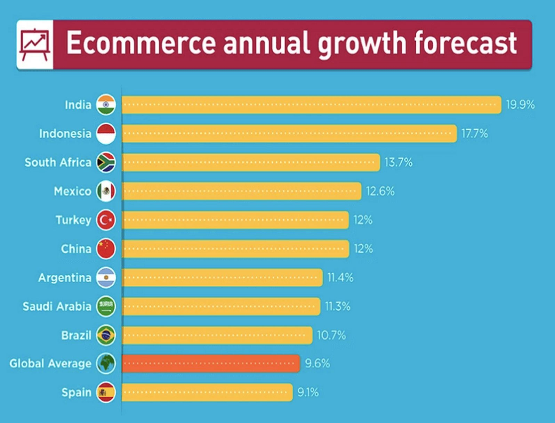
Where is the world going? Where is the Kyrgyz Republic?
Exercise: Find out where it is the Kyrgyz Republic among the global growth of e-commerce.
- What are the key areas of growth?
- What are the key industries you will see growing on the Internet?
Source: https://wedevs.com/blog/266954/future-ecommerce-trends
TA6618-Enabling a conducive environment for e-commerce
Module 2 - Digital Technologies role in enhancing business activity / e-commerce platform

Slide 7
Model Transformation: SME’s Digital in Business
SME’s, use digital content, IT support in production activities, marketing and selling, and for the tasks of payments and deliveries.
In business process
Digital Content
In business function
Digital SME’s
Start up Platform
Startup business: New business based on web/ TI/internet.
- Application software
- Digital marketing Agency
- Cloud based service
Startup platform is when a new business is using an IT based platform as facilities to get support and impulse for its business activities.
TA6618-Enabling a conducive environment for e-commerce
Module 2 - Digital Technologies role in enhancing business activity / e-commerce platform
Created model: Suwandi - 2017
Notes:
30

Slide 8
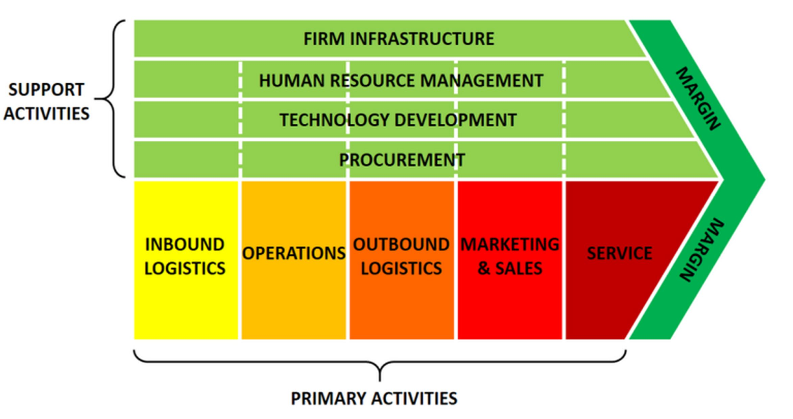
Porter’s Value Chain
E-Commerce’s role in business activity
TA6618-Enabling a conducive environment for e-commerce
Module 2 - Digital Technologies role in enhancing business activity / e-commerce platform
Source: https://www.business-to-you.com/value-chain/

Slide 9
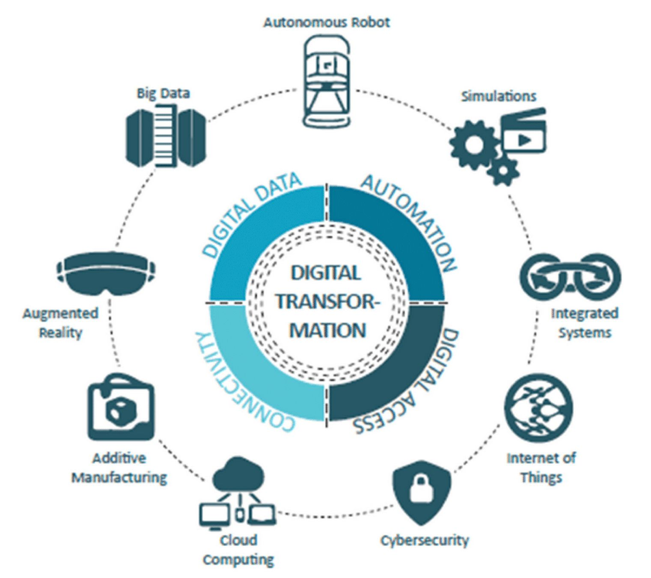
Digital transformation and actives to be aware of
Source: https://www.researchgate.net/figure/Industry-40-Key-concepts-and-digital-technologies-source-Image-created-by-author-C_fig1_349974274
TA6618-Enabling a conducive environment for e-commerce
Module 2 - Digital Technologies role in enhancing business activity / e-commerce platform

Slide 10
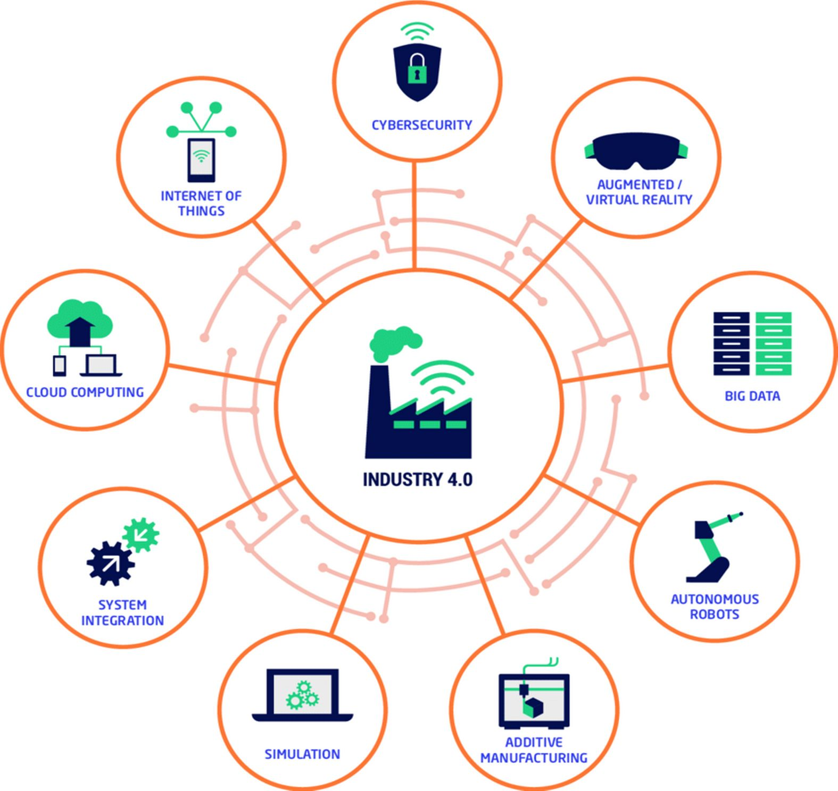
Digital platforms
There are various digital platforms for SME’s and governments to take
advantage of IT.
But also the same available technologies can be used to deliver E-commerce goods and services.
Source: https://www.researchgate.net/figure/Overview-of-the-nine-technological-pillars-of-Industry-40_fig2_346901544
TA6618-Enabling a conducive environment for e-commerce
Module 2 - Digital Technologies role in enhancing business activity / e-commerce platform

Slide 11
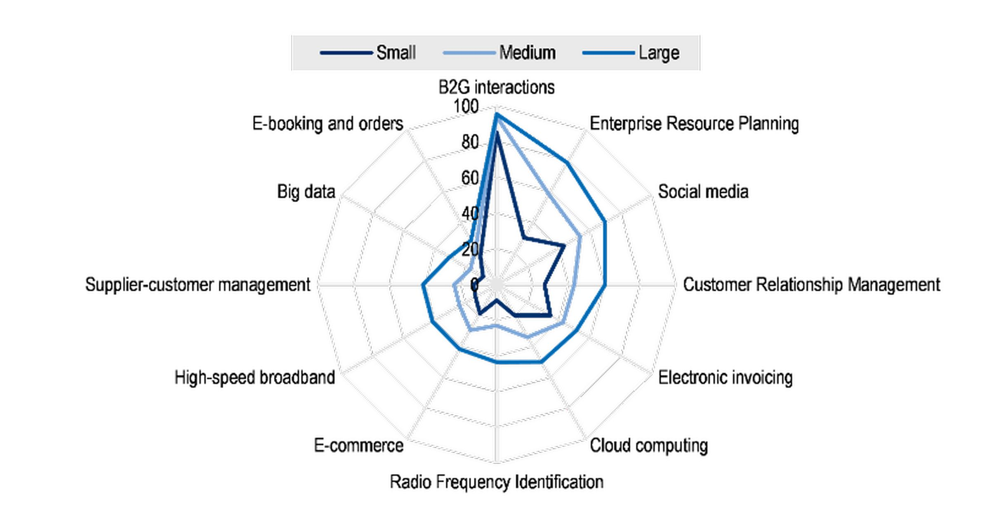
Are you ready for digital technology platforms?
How prepared are you to be fully capable to perform in an e-commerce environment?
Source: https://www.oecd.org/innovation/the-digital-transformation-of-smes-bdb9256a-en.htm
TA6618-Enabling a conducive environment for e-commerce
Module 2 - Digital Technologies role in enhancing business activity / e-commerce platform

Slide 12
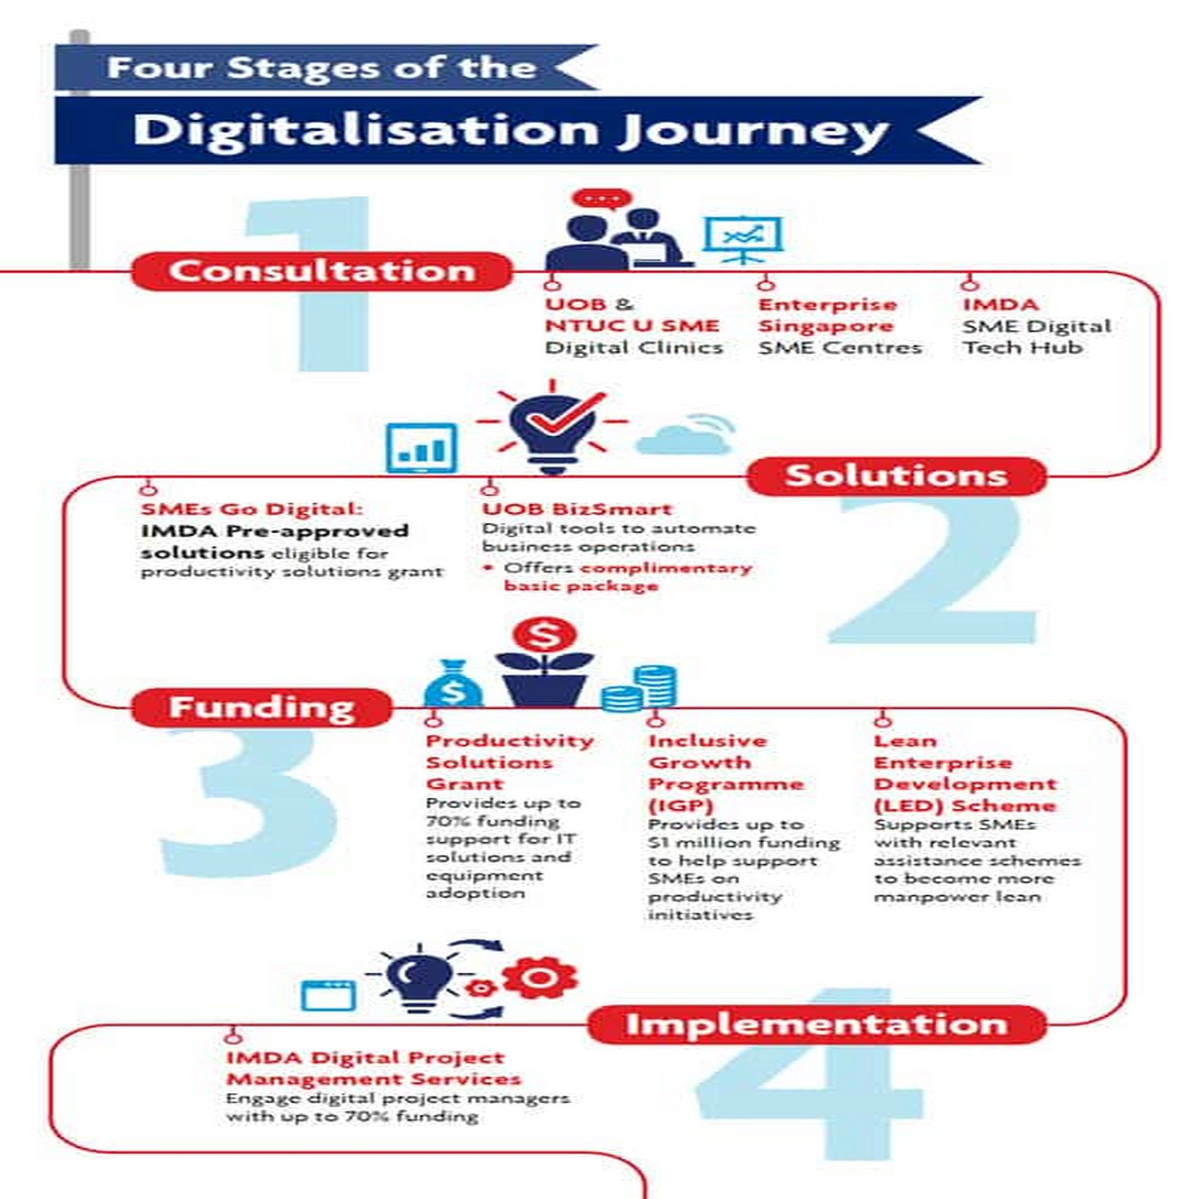
The digital transformation
Source:
https://www.uob.com.sg/business/sme-hub/insights/sme-digitalise.page
TA6618-Enabling a conducive environment for e-commerce
Module 2 - Digital Technologies role in enhancing business activity / e-commerce platform

Slide 13
Conclusions for Module 2
Even with the support of IT, a business is a business
There is a process called Digital Transformation that you need to be aware of.
You should integrate human roles in IT platforms or tools.
There are many platforms and technologies you need to know as they may be of use in your e-commerce business processes.
You should understand and impact where the market is expecting due to the use of IT platforms and tools and adapt your organization to it.
TA6618-Enabling a conducive environment for e-commerce
Module 2 - Digital Technologies role in enhancing business activity / e-commerce platform

Slide 14
Extend your knowledge
Find in the following slides, more resources, images and diagrams which may help you in extending and completing your knowledge about the contents on this module.
You can use them as complement of the key resources already given.
TA6618-Enabling a conducive environment for e-commerce
Module 2 - Digital Technologies role in enhancing business activity / e-commerce platform

Slide 15
Extend your knowledge
Digital Technologies in Business
Review the set of last-generation IT technologies which may be of help in boosting your e-commerce idea
https://spravochnick.ru/informatika/cifrovye_tehnologii_v_biznese/
TA6618-Enabling a conducive environment for e-commerce
Module 2 - Digital Technologies role in enhancing business activity / e-commerce platform

Slide 16
Extend your knowledge
Business Digital Transformation
All you need to have in mind to move from a traditional business model into a digitally holded business
https://doczilla.pro/ru/blog/digital_business_transformation/
TA6618-Enabling a conducive environment for e-commerce
Module 2 - Digital Technologies role in enhancing business activity / e-commerce platform

Slide 17
Extend your knowledge
Implementation of digital capacity in northern and central Asia
Have a look to this report of UNECE and get a full picture of the “State of Art” about e-business in Central Asia.
E_Справочный_документ_-_РЕАЛИЗАЦИЯ_ЦИФРОВОГО_ПОТЕНЦИАЛА_В_СЕВЕРНОЙ_И_ЦЕНТРАЛЬНОЙ_АЗИИ
TA6618-Enabling a conducive environment for e-commerce
Module 2 - Digital Technologies role in enhancing business activity / e-commerce platform

Slide 18
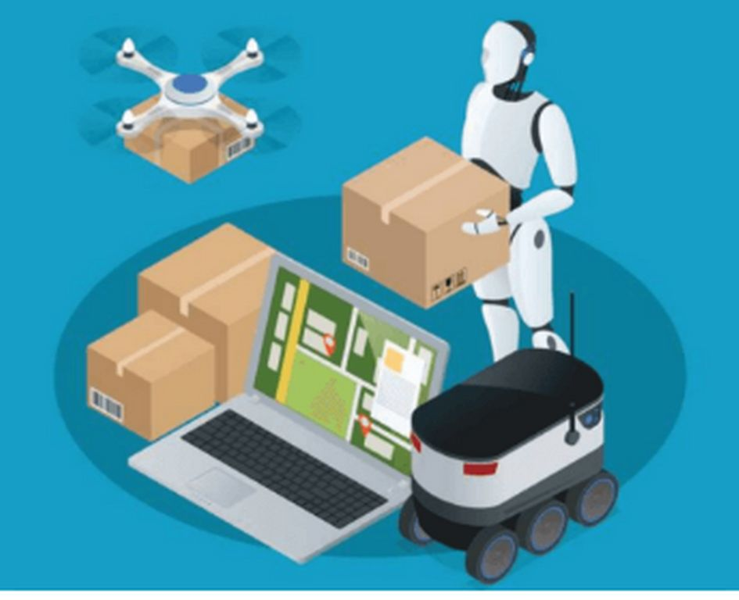
Extend your knowledge
Digital Technologies in Business: What to use to deal with the crisis
Have a look to this report of UNECE and get a full picture of the “State of Art” about e-business in Central Asia.
https://eternalhost.net/blog/perevody/tsifrovye-tehnologii-v-biznese
TA6618-Enabling a conducive environment for e-commerce
Module 2 - Digital Technologies role in enhancing business activity / e-commerce platform

Slide 19
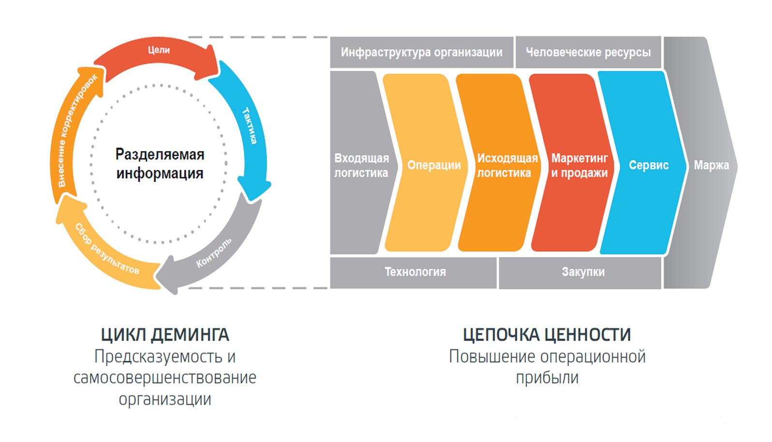
Extend your knowledge
The value chain in Porter’s model
A deeper understanding of the Porter’s model in e-business and the value it implies.
https://finzz.ru/cepochka-cennostej-portera-primer-kak-postroit.html
Source:
https://ru.wikipedia.org/wiki/%D0%A6%D0%B5%D0%BF%D0%BE%D1%87%D0%BA%D0%B0_%D1%86%D0%B5%D0%BD%D0%BD%D0%BE%D1%81%D1%82%D0%B8
TA6618-Enabling a conducive environment for e-commerce
Module 2 - Digital Technologies role in enhancing business activity / e-commerce platform

Slide 20
Extend your knowledge
How to use this model in your business
Competitive advantages, objectives and analysis.
https://actualmarketing.ru/tools/tsepochka-tsennostey/
TA6618-Enabling a conducive environment for e-commerce
Module 2 - Digital Technologies role in enhancing business activity / e-commerce platform

Slide 21
Extend your knowledge
Development of E-Commerce in Central Asia
How E-Commerce will impact Kyrgyz Republic as a part of the Eurasian Economic Union.
https://online.zakon.kz/Document/?doc_id=35137989
TA6618-Enabling a conducive environment for e-commerce
Module 2 - Digital Technologies role in enhancing business activity / e-commerce platform

Slide 22
Extend your knowledge
Online platforms in the system of modern international digital trade
The theoretical and methodological framework of the considered aspects includes foreign and domestic studies in the field of digitalization and the digital transformation of the world economy.
https://e-management.guu.ru/jour/article/view/96?locale=ru_RU
TA6618-Enabling a conducive environment for e-commerce
Module 2 - Digital Technologies role in enhancing business activity / e-commerce platform

Slide 23
Extend your knowledge
Digital transformation in practice
Instructions and steps to implement a process of digital transformation.
https://aif.ru/society/opinion/cifrovaya_transformaciya_v_prakticheskih_sovetah
TA6618-Enabling a conducive environment for e-commerce
Module 2 - Digital Technologies role in enhancing business activity / e-commerce platform

Slide 24
Extend your knowledge
Business digital transformation: five real-life examples
Understanding cases of success and how they did it.
https://processmi.com/blog/czifrovaya-transformacziya-biznesa-pyat-realnyh-primerov/
TA6618-Enabling a conducive environment for e-commerce
Module 2 - Digital Technologies role in enhancing business activity / e-commerce platform

Slide 25
Extend your knowledge
How grows your wallet with online business
The growth of online business and the main sectors and inconveniences they face.
https://inbusiness.kz/ru/news/kak-tolsteet-onlajn-koshelek
TA6618-Enabling a conducive environment for e-commerce
Module 2 - Digital Technologies role in enhancing business activity / e-commerce platform

Slide 26
Workshop Business Plan Development
Executive Summary
The Executive Summary of a Business Plan is a 3-5 paragraph introduction to your Business Plan.
The Executive Summary is critical, because many individuals (including venture capitalists) only read the summary.
The Executive Summary section includes:
A first paragraph that introduces your business.
Your business name and location.
A brief explanation of customer needs and your products or services.
The ways that the product or service meets or exceeds the customer needs.
An introduction of the team that will execute the Business Plan.
Subsequent paragraphs that provide key details about your business, including projected sales and profits, unit sales, profitability, and keys to success.
Visuals that help the reader see important information, including highlight charts, market share projections, and customer demand charts.
TA6618-Enabling a conducive environment for e-commerce
Module 2 - Digital Technologies role in enhancing business activity / e-commerce platform

Slide 27
Workshop Business Plan Development
Business Concept
The business concept shows evidence that a product or service is viable and capable of fulfilling an organization's particular needs.
The Business Concept section:
Articulates the vision of the company, how is you plan to meet the unique needs of your customer, and how is you plan for making money doing that.
Discusses feasibility studies that you have conducted for your products or services.
Discusses diagnostic sessions you had with prospective customers of your products and services.
Captures and highlights the value proposition in your product or service offerings.
TA6618-Enabling a conducive environment for e-commerce
Module 2 - Digital Technologies role in enhancing business activity / e-commerce platform

Slide 28
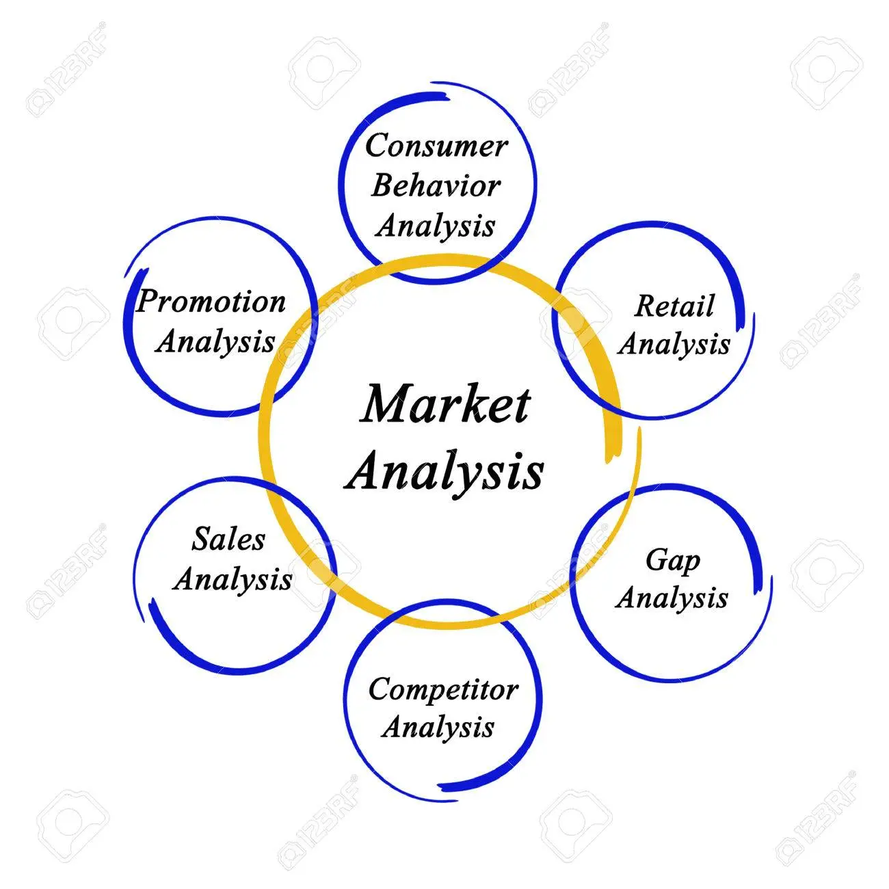
Workshop Business Plan Development
Market Analysis
A Market Analysis defines your target market so that, you can position your business to get its share of sales. And it has the following sections:
Defines your market.
Segments your customers.
Projects your market share.
Positions your products and services.
Discusses pricing and promotions.
Identifies communication, sales,
And distribution channels.
Source:
https://www.123rf.com/photo_41935395_market-analysis.html
TA6618-Enabling a conducive environment for e-commerce
Module 2 - Digital Technologies role in enhancing business activity / e-commerce platform

Slide 29
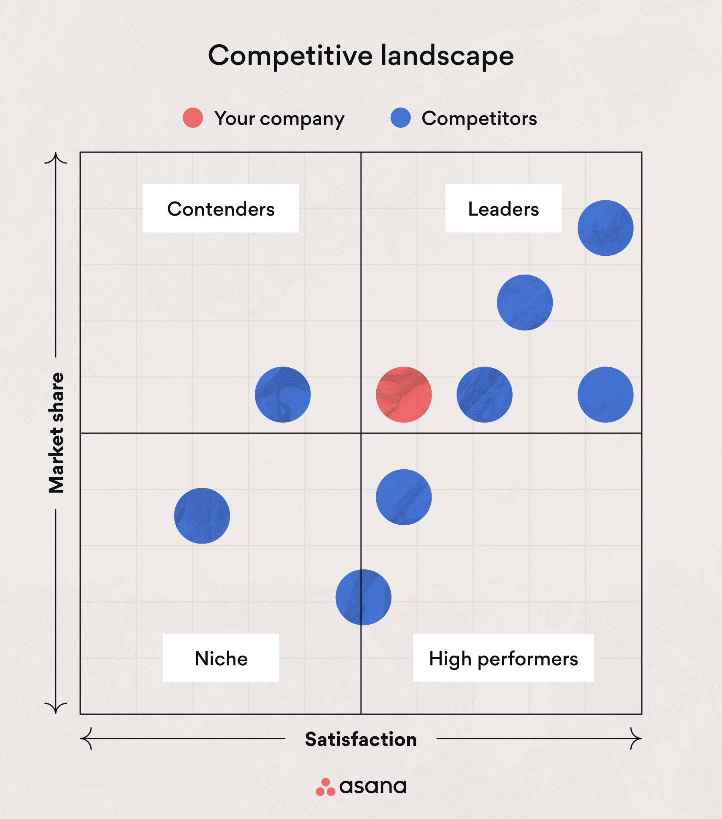
Workshop Business Plan Development
Competitive analysis
A competitive analysis can make or break your venture:
Know who else is a direct competitor
Who is an indirect competitor
Substitutes
Your positioning in the market.
Key differentiator, price, offering, features
Source: https://asana.com/resources/competitive-analysis-example
TA6618-Enabling a conducive environment for e-commerce
Module 2 - Digital Technologies role in enhancing business activity / e-commerce platform

Slide 30
End of Module 2
Thanks for watching
TA6618-Enabling a conducive environment for e-commerce
Module 2 - Digital Technologies role in enhancing business activity / e-commerce platform

